Slide 1
Vasculitis
Inflammation of the blood vessel wall.
1- Direct infection (Bacterial, Viral)
2- Immunologic mediated (Systemic Lupus Erythematosus, Henoch-Schonlein Purpura)
3- Unknown (Giant cell arteritis, Polyarteritis nodosa)

Slide 2
Giant cell (temporal) vasculitis:
Chronic granulomatous inflammation affecting large to small sized arteries mainly the arteries of the head, blindness may occur especially if the ophthalmic artery is involved.

Slide 3
Pathogenesis
It is unknown, but there is evidence of T-cell mediated immune response.

Slide 4
Morphology
Nodular intimal thickening with reduction of the lumen and occasional thrombosis. Granulomatous reaction limited to the inner half of the media centered on internal elastic membrane.

Slide 6
Thromboangiitis Obliterans (Buerger Disease)
Segmental thrombosing acute and chronic inflammation of medium-sized and small arteries mainly tibial and radial arteries. Occur exclusively in heavy smokers.

Slide 7
Pathogenesis:
Patients have hypersensitivity to tobacco products and there is direct toxicity to endothelium by tobacco.

Slide 8
Morphology:
Sharply segmental acute and chronic vasculitis of medium-sized and small arteries of the extremities. Microscopically Acute and chronic inflammation accompanied by luminal thrombosis.

Slide 10
Vascular Tumors:
Tumors of blood vessels and lymphatics range from benign hemangiomas to intermediate lesions that are locally aggressive but infrequently metastatic, to relatively rare highly malignant angiosarcoma.

Slide 11
Benign Tumors:
1- Hemangioma:
Are very common tumors characterized by increased numbers of normal or abnormal vessels filled with blood. These tumors constitute 7% of all benign tumors of infancy and childhood. Most are present at birth but may regress spontaneously. Malignant transformation is rare.

Slide 12
a- Capillary hemangioma. It is the most common variant occur in the skin, subcutaneous tissue, mucous membrane. Appears bright red to blue and vary from few millimeters to several centimeters. Histologically there are unencapsulated aggregates of closely packed thin walled capillaries filled with blood.

Slide 14
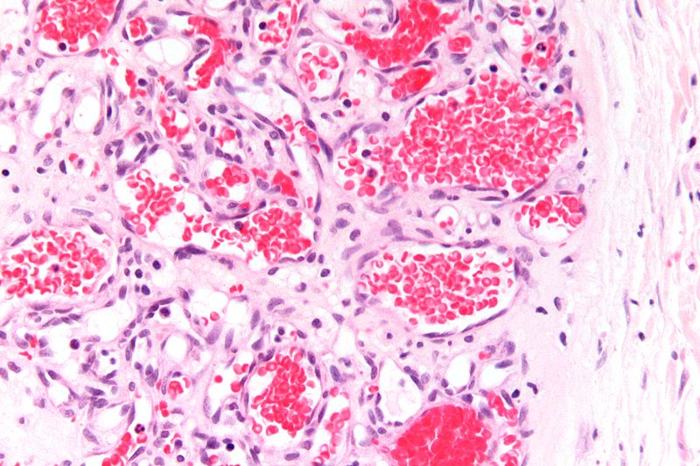

Slide 15
b- Cavernous hemangioma. These are characterized by large dilated vascular channels unencapsulated and involving deep structures. 1-2 cm in diameter. Histologically composed of cavernous blood filled vascular spaces.

Slide 16
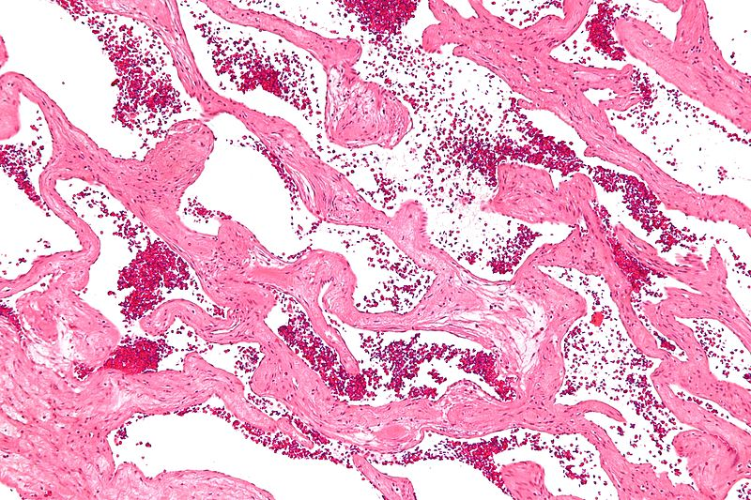

Slide 17
2- Lymphangioma:
Are benign lymphatic tumors analogue of hemangioma. Also consists of 2 types:
1- Simple capillary Lymphangioma
2- Cavernous Lymphangioma. (Cystic hygroma).

Slide 18
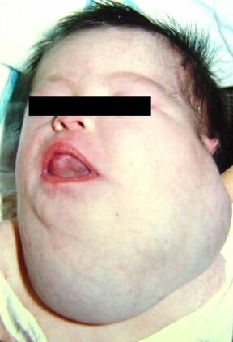

Slide 19
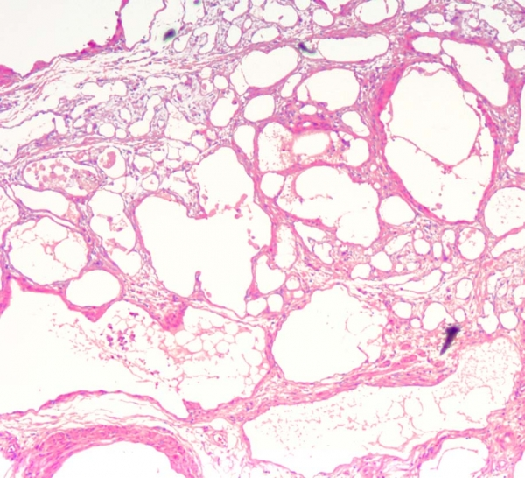

Slide 20
Intermediate Grade Tumors:
Kaposi Sarcoma:
It is common in patients with AIDS, and is caused by a virus of herpes virus subfamily , but can occur in HIV negative patients.
The pathogenesis is uncertain, but there is evidence of virus associated neoplasm ( herpes Virus type 8).
Morphology : It passes thru three stages ( patch, plaque and nodule), composed of plump, proliferating endothelial cells.

Slide 21
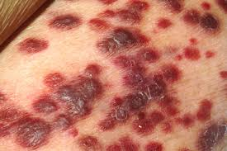
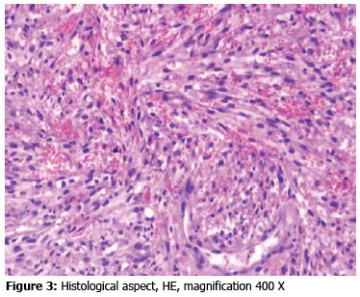

Slide 22
Hemangioendothelioma
Vascular tumor occur around medium-sized, and large veins., composed of plump endothelial cells, and vascular channels.
Recurrence rate is high, but rarely give metastasis.

Slide 23
Malignant Tumors:
Angiosarcoma:
Is a malignant endothelial neoplasms with histology varying from highly differentiated tumors to anaplastic tumors. Hepatic angiosarcoma are associated with exposure to arsenic.
It is aggressive tumor with a 5-year survival rate of 30%.

Slide 24
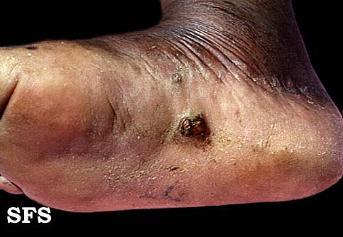
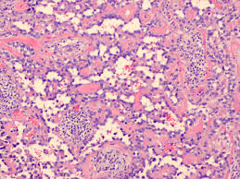
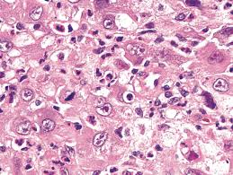

Slide 25
Cardiac Tumors
1-Metastatic tumors: More common than primary, mainly involving the pericardium causing pericarditis or pericadial effusion. Mainly from lung, breast, melanoma or lymphoma.
2- Primary tumors: Are rare, the most common is:
Myxoma: Benign tumor arise in the left atrium, can occur in adult at any age. Although benign but may cause problems, affecting the blood flow thru atrium , and may pieces from tumor detach to form embli.

